Slide 1
Six Parallel Classifications
Basic Classification
Undergraduate Instructional Program
Graduate Instructional Program
Enrollment Profile
Undergraduate Profile
Size & Setting
Community Engagement (elective classification)

Slide 2
Basic Doctoral: Aggregate Metrics
Doctorates: STEM (NCES IPEDS)
Post Docs and PhD-holding Research Staff (NSF GSS)
S&E R&D Expenditures (NSF HERD)
Doctorates: Social Sciences (NCES IPEDS)
Non-S&E R&D Expenditures (NSF HERD)
Doctorates: Humanities (NCES IPEDS)
Doctorates: Other Fields (NCES IPEDS)

Slide 3
Basic Doctoral: Per Capita Metrics
Per-capita S&E R&D Expenditures
Per-capita Post Docs and Research Staff
Per-capita Non-S&E R&D Expenditures
(Asst + Assoc + Full Prof in denominator)

Slide 4
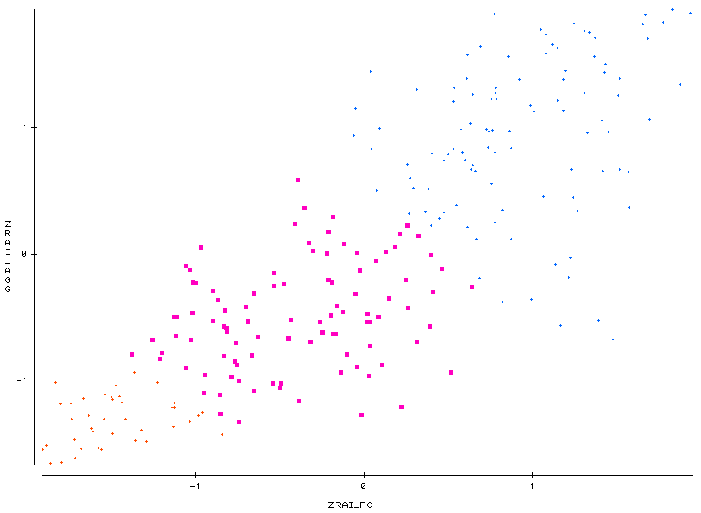
Metrics Combined
2010 Basic Classification, Research Universities
http://carnegieclassifications.iu.edu/2010/downloads/Research_Activity_Index_2011CC.xls
RUVH
Aggregated Research Activity Index
RUH
DRU
Per-capita Research Activity Index

